Slide 1

Tribal Land Playbook Data Collection Kit

Slide 2
Introduction
Site Data Collection is an important step in the journey to develop the business plan for your network. This process involves a physical visit to existing facilities and site where equipment could be installed as part of the network. The data collected is intended to be utilized during the network design process, whether this process is performed by your Tribe or by a third-party consultant or the equipment vendor.
For this purpose, the Data Collection Kit provides you with clear guidelines to identify and collect the must important information from a candidate location.
In addition, this kit guides you through the generation of a map where sites’ information will be gathered and managed. From this set of instructions, you will be able to operate the map application through a smartphone or a PC.
Finally, you will be instructed on how to capture the required photographic evidence of each site. Photographic evidence is crucial for the evaluation of a site suitability to support a site deployment on it.

Slide 3
Data Collection Guidelines
Using My Maps: PC+ Smartphone
Using My Maps: PC Only
Photo Report Guidelines
Export your data

Slide 4
Data Collection Guidelines
General Guidelines
1
Before collecting data from a site, verify that the site can be utilized for network deployment, i.e., confirm with Tribal authorities or site owner/responsible, and check for any regulation restrictions.
2
Before going on-site, try to collect as much data as possible and ensure access to the site in advance.
3
Before leaving the site do a double-check of the list of attributes required to avoid getting back later in the process.
4
For site visits, always bring a smartphone, notebook and measure tape.

Slide 5
Data Collection
Item-Specific Guidelines (1/4)
The following are site attributes to be reported during site visit.
Mandatory attributes must always be reported.
Decision to report optional attributes will depend on site/facility characteristics.
Mandatory
Descriptive name of the site.
Free use of characters.
Try to avoid duplicated names.
Site Name
Text that uniquely identifies the site. Site IDs must not have duplicates.
Simple numbering can be used, in absence of a more sophisticated naming convention.
Ideally all the Site IDs have the same number of characters.
Mandatory
Site ID
Mandatory
Coordinates that define site location.
Initial coordinates as seen on the smartphone can be registered. Afterwards, edition can be done for accuracy looking at the satellite view of the map.
Latitude & Longitude
Short sentence describing current use of the facility (e.g., tribal / government building, school, telecom tower, water tower).
Mandatory
Primary Function

Slide 6
Data Collection Guidelines
Item-Specific Guidelines (2/4)
Mandatory
Specify the type of structure/building.
At least consider the following option: Water tower, warehouse, Tribal building, Telco Tower.
Type of Facility
Optional
Owner/Contact
Register the name of the person or entity that owns/administers the building.
Optional
Contact Phone/email
Register the contact phone or email to facilitate communications at a later stage.
Optional
While on-site, and preferably from a high point, look for near-by obstacles of the same height or taller than the surveyed site. If such obstacles exists, fill this attribute with the number of obstacle.
Nearby Obstacles
Optional
Whenever obstacles are found in the previous step, provide a brief description for each of them.
A photo is required as specified in the photo report guidelines of this document.
Obstacle Description

Slide 7
Data Collection Guidelines
Item-Specific Guidelines (3/4)
Mandatory
Estimate of the height at which radio equipment could be installed on this facility.
For telco towers or other types of tower try to estimate height based on height of other known structures.
For Buildings, estimate based on the number of floors and assume 3.5 m per floor 1.5 m of a rooftop mast.
Antenna Install Height (m)
Tower Base Diameter (m)
Mandatory
Measure the diameter of the base of the tower infrastructure (if applicable).
Mandatory
Estimate the available longitudinal space on the tower to install the radio equipment at the desired height.
Tower Space (m)
Mandatory
Measure or estimate through visual inspection the available space on the floor (for facilities without shelter or equipment room).
Floor Space (sq m)
Mandatory
Input voltage from the electrical company in case the service is available.
Common values: 120V, 240V, 480V, N/A.
Existing AC Voltage

Slide 8
Data Collection Guidelines
Item-Specific Guidelines (4/4)
Optional
Other Power Sources Capacity
Power Capacity of other existing power sources on site such as diesel generators.
Information can be obtained from Site owner / responsible.
Mandatory
Equipment Room Available Space (m ft)
Measure or estimate through visual inspection the available space on the equipment room (if applicable).
Optional
Cooling
If the facility has a cooling system in the equipment room write “Yes”, otherwise write “No”.
Information can be obtained from Site owner / responsible.
Mandatory
Backhaul Type
If the facility has connectivity to internet or other networks, specify the type of connection.
Values: Fiber, Microwave, Satellite, xDSL.
Optional
Backhaul Speed
Backhaul Capacity in Mbit/s.
Information can be obtained from site owner/responsible.
Optional
Write down the model of the backhaul equipment. (Photo required as specified in the photo report guidelines in this document).
Backhaul Equipment

Slide 9
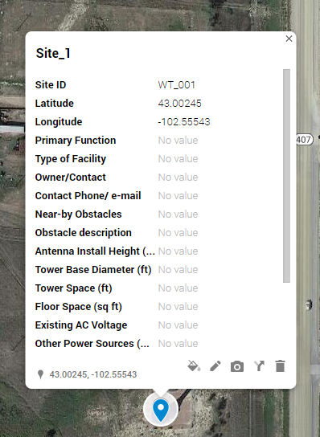
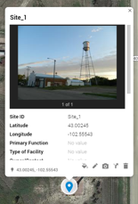
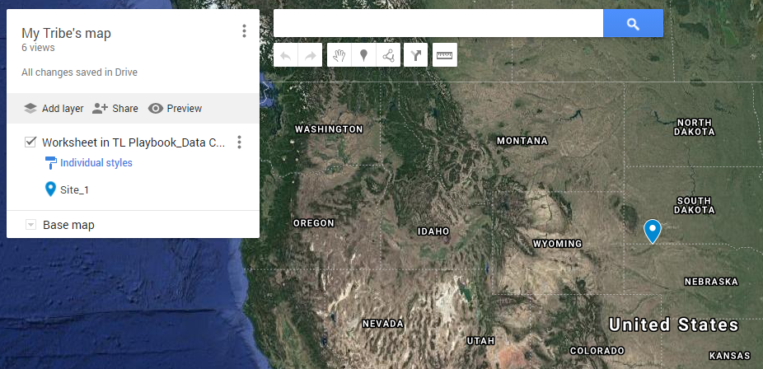
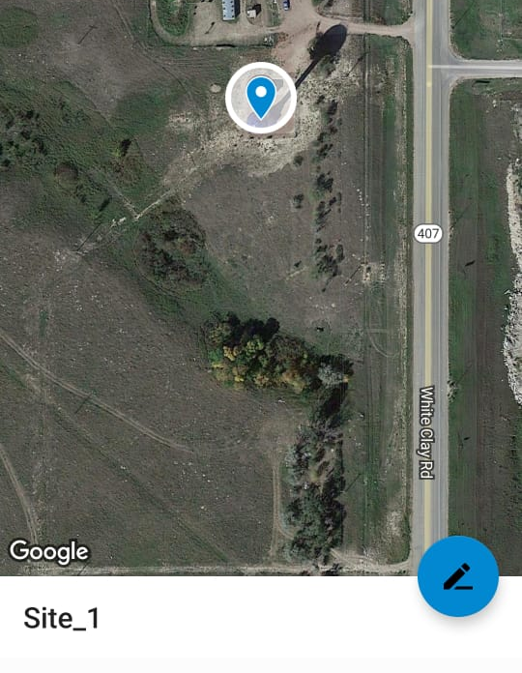


Using My Maps for site data collection
Introduction
“Google My Maps” is an application intended to create your own maps in a fast an easy way.
This app allows you to gather data required for Network Planning and Feasibility Analysis.
My Maps also allows you to share the map with as many people as required.
Data Collection in My Maps
Map creation:
Create map for your Tribal land.
Site addition:
Add as many sites as required to your map.
Photo addition:
Add photographic evidence for every site.
Map data export:
Export map data for future processing.

Slide 10


Using My Maps for site data collection
Introduction – Options to use My Maps
My Maps can be used from a smartphone or from a PC.
Each option provides its own benefits and provide flexibility to the utilization of “My Maps”.
Smartphone
PC
Recommended option.
With the smartphone you will be able to:
Add sites and related information
The smartphone can be used to register the data directly in My Maps on the field.
My Maps app will require an internet connection to display the map. As an alternative, you can pre-load the map of the area before going on-site.
This option complements and may replace the use of the smartphone.
If not using the smartphone, required attributes are written down in paper while on site and then, they are transferred to the PC and My Maps.
With the PC option you will be able to:
Create your own map
Add sites and related information
Upload photos from the site
Export data from the map to KML or CSV formats

Slide 11
Using My Maps: PC + Smartphone
Map creation
Despite being the most comfortable option, the smartphone presents one crucial limitation: when a map is created from it, you are not able to fill all the required site attributes as defined by the “Item-Specific Guidelines”.
For this reason, you must create your map using a PC before starting the site visit. You can choose between two ways for the map creation.
Create the map using a
dummy site
Create a map with a single example site that will only serve to create the framework with all required attributes.
Map Creation
w/PC
If you have your site(s) already defined (Site Name, Site ID and coordinates), you can fill the template with that information and create the map from it.
Create the map with the known coordinates of the sites to visit
Templates for each option will be provided on its corresponding section.

Slide 12
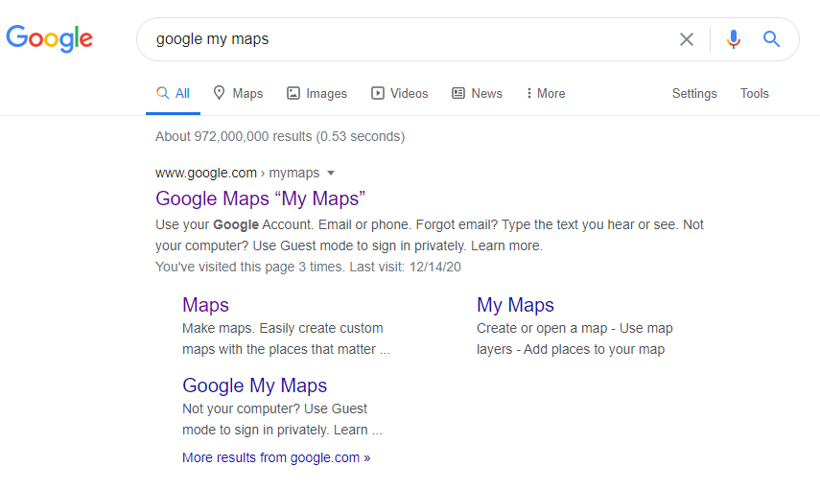
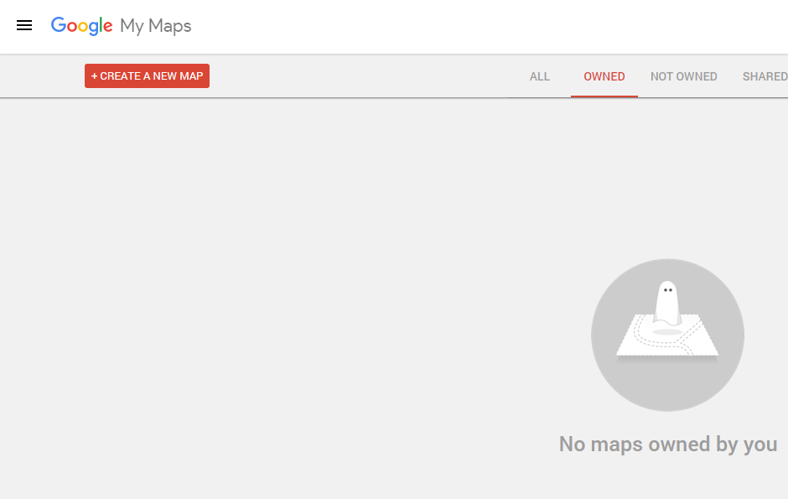
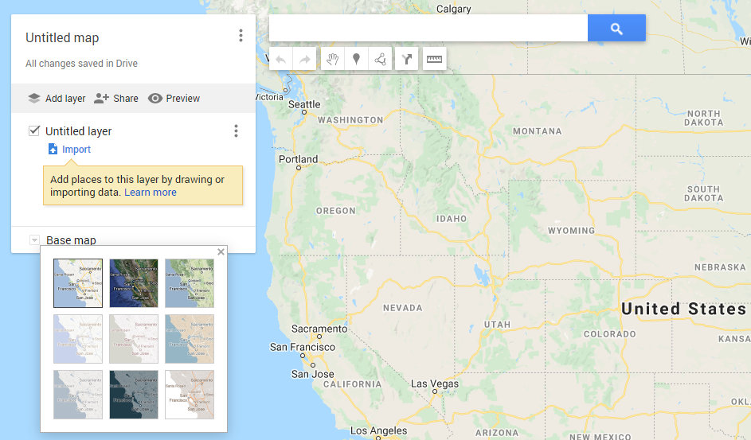
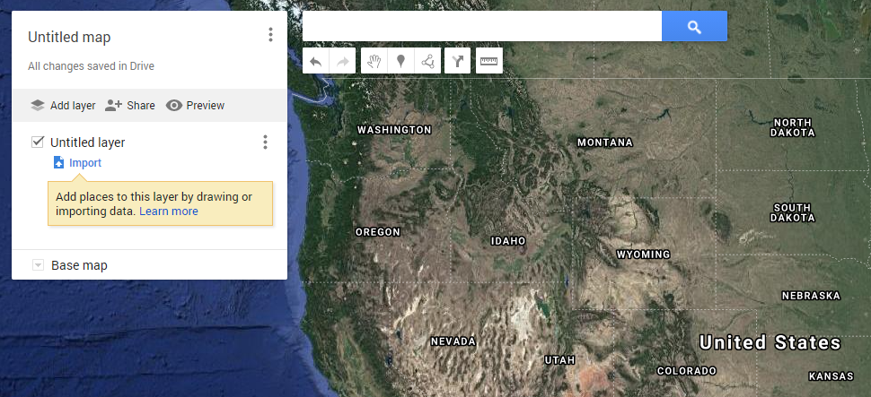
Using My Maps: PC + Smartphone
Map creation
1
2
Access “My Maps”
Create a new map
Access to the web application through any browser.
Click on the “CREATE A NEW MAP” button.
3
Select a satellite top view
Click on the “Base map” and select the “Satellite” option.

Slide 13
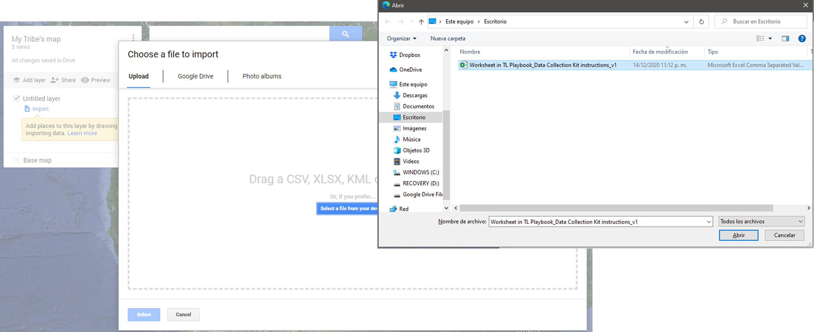
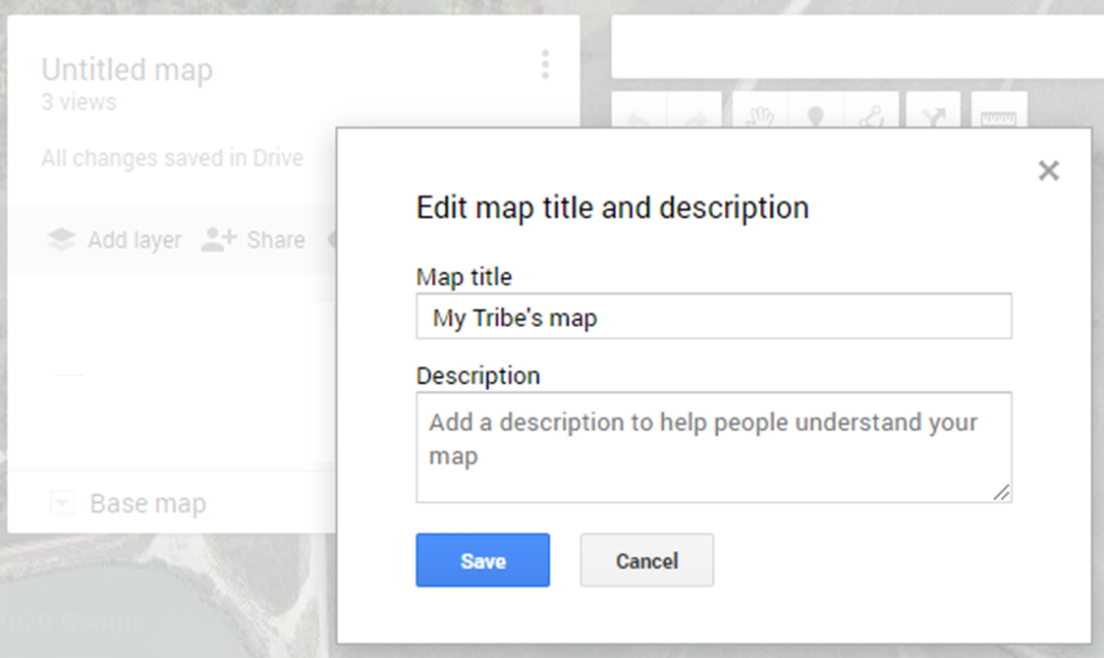
Using My Maps: PC + Smartphone
Map creation
5
4
Name your map
Import your data
Click on the “Untitled map” cell.
Define a name for the map.
It must unique, easy to remember and descriptive of your Tribal Nation.
Click on the “Import” button and select one of the following documents depending on your map creation option: Dummy site or Site data fill template.
Open the file and save it as
“CSV (Comma delimited)”.
Fill the template and save it as “CSV (Comma delimited)”.

Slide 14
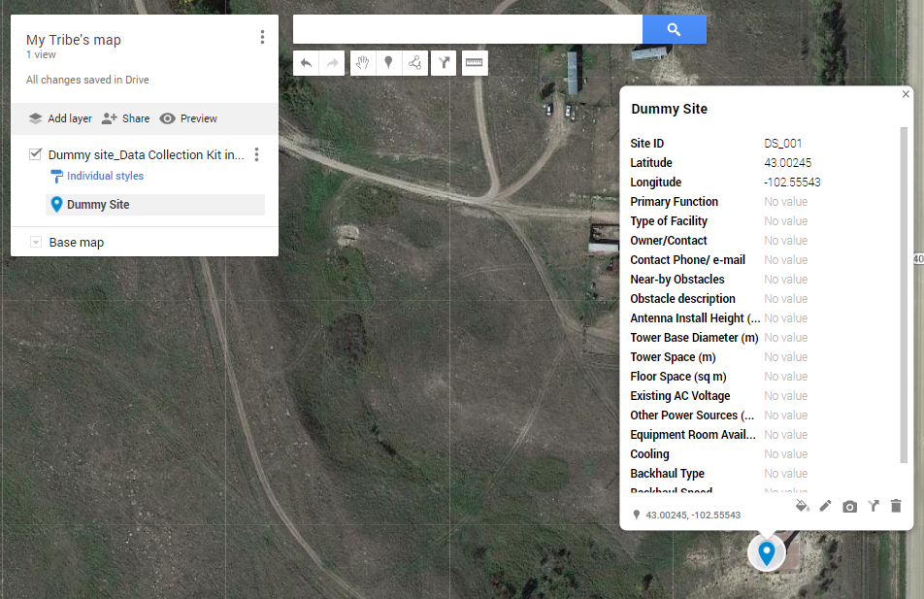
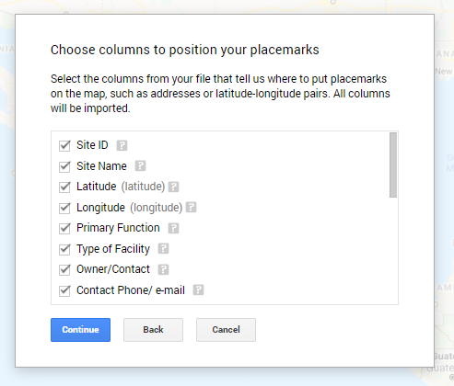
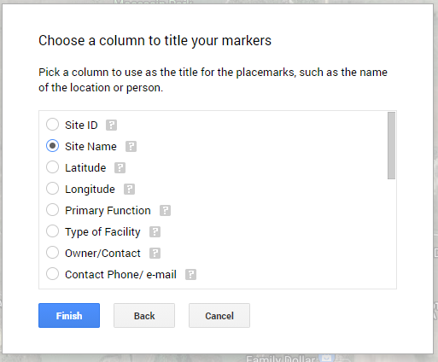
Using My Maps: PC + Smartphone
Map creation
8
6
7
Sites information placeholders
Name your marker
Site’s view
Select all available attributes to create placeholders.
This will allow to fill each attribute during site visit (for smartphone option).
It is recommended to name the marker after the Site ID or the Site Name.
For this example, we named it after the Site Name.
This is how your site will see.
(This example considers the Dummy site option).

Slide 15


Using My Maps: PC + Smartphone
Summary
Smartphone option Summary
During the site visit you will be able to:
Add as many sites as required
Capture photographic evidence to be uploaded on a PC once the visit has finished.
Several team members can access the same map simultaneously and work independently adding their own sites.

Slide 16
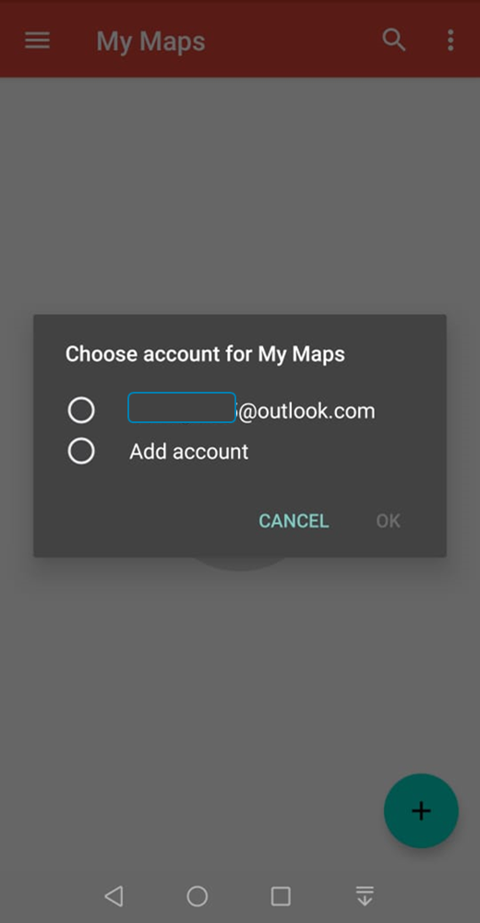
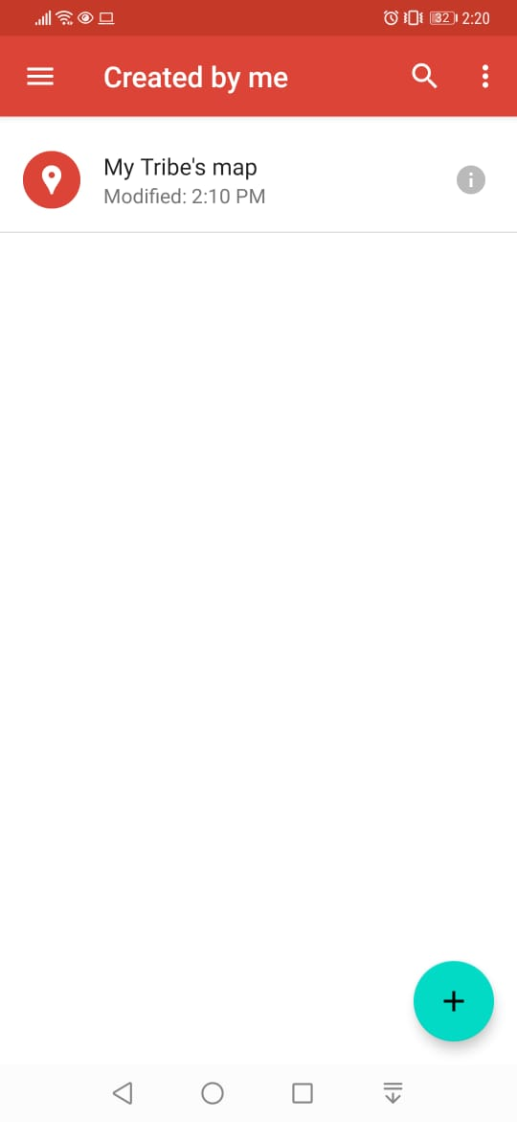
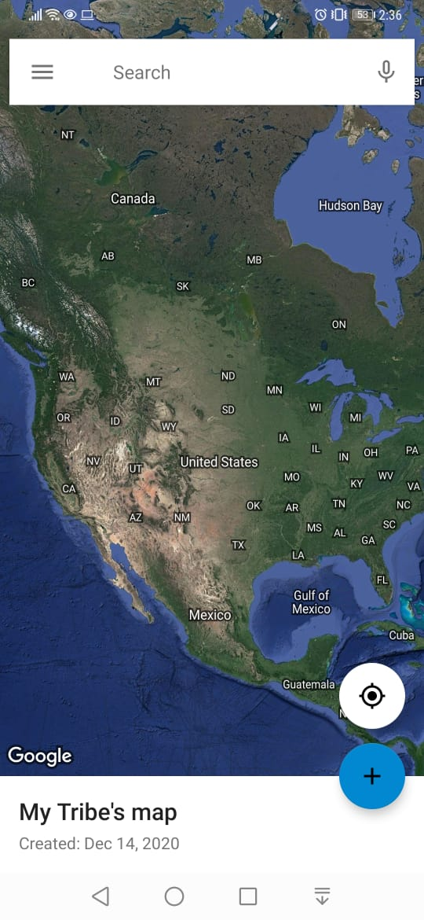
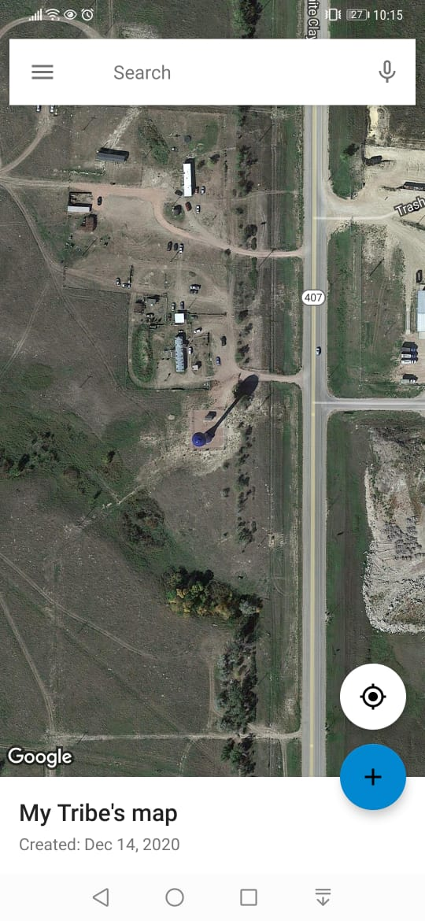
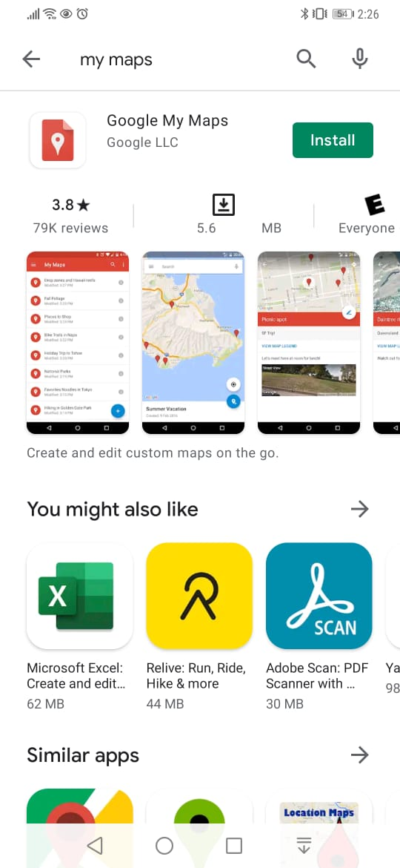
Using My Maps: PC + Smartphone
Site addition – Smartphone
2
3
4
5
1
Get the app
Set an account
Open you map
Center the map
Add new site
Download the
“Google My Maps” app.
Input a Google account to use the app.
Open your recently created map.
Click on the compass icon to center the map on yourself.
Click on the plus (“+”) to add a new site.

Slide 17
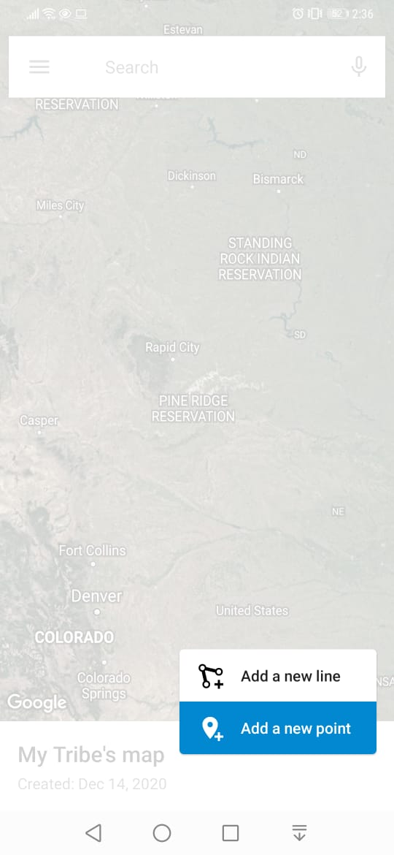
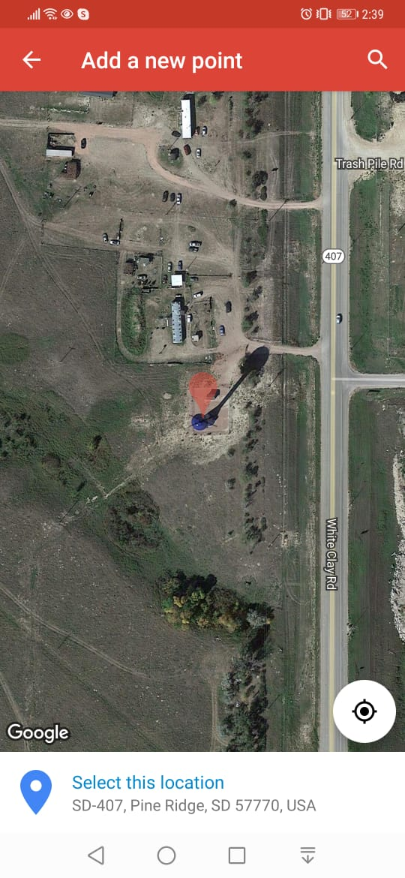
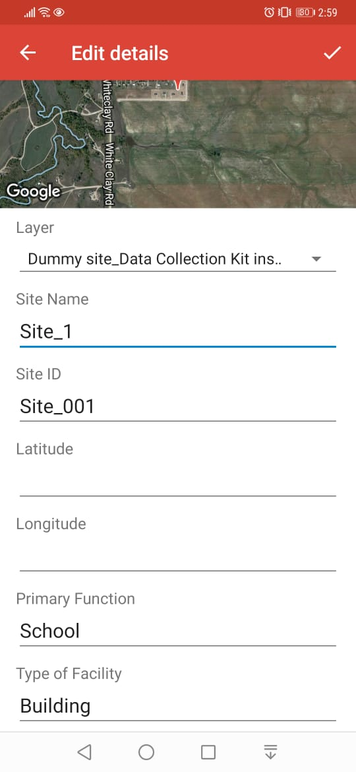
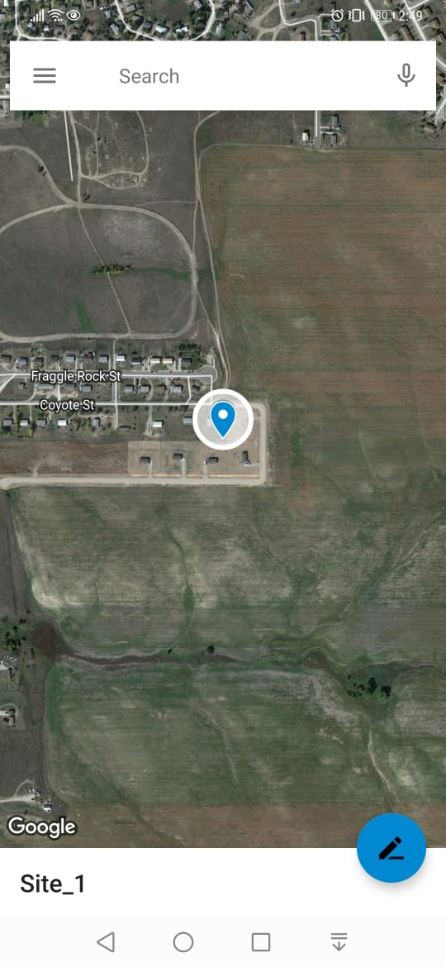
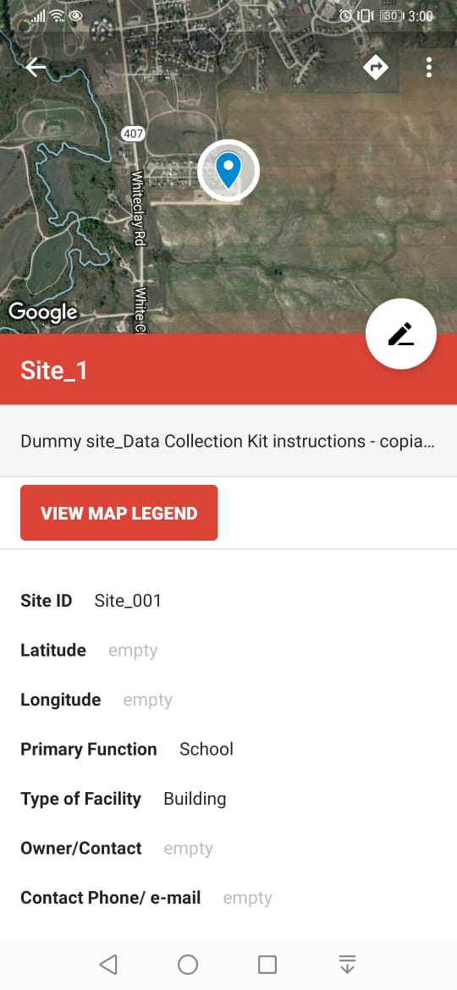
Using My Maps: PC + Smartphone
Site addition – Smartphone
6
7
8
9
Add new site
Locate your site
Fill site attributes
Final view of the site
Select the “Add a new point” option.
You can drag the marker exactly on the spot you want to register. Then click on “Select this location”.
Fill site attributes.
Don’t worry for filling “Latitude” and “Longitude” cells. It will be done automatically.
Click on the thick icon to finish.
This is how the site will see.
Don’t worry if “Latitude” and “Longitude” cells appear as empty. They aren’t.

Slide 18
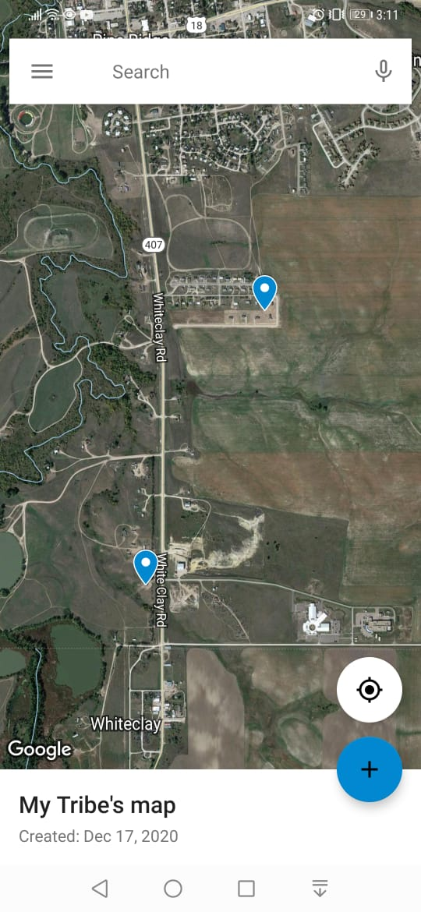
Using My Maps: PC + Smartphone
Site addition – Smartphone
10
Photographic data upload and Map data export
The “Google My Maps” app doesn’t allow to upload photos from the smartphone.
The photo addition must be done from the PC (see instructions in slide 23).
Map export must be done also from the PC (see instructions in slide 34).
Add new sites
Repeat from step 5 to add new sties.

Slide 19

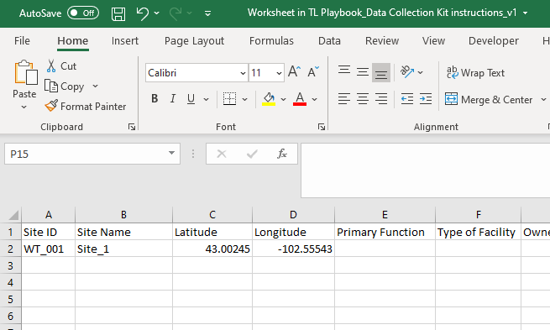
Using My Maps: PC
Summary
PC option Summary
During the site visit you must take note of site attributes on a printed version of the Site data fill template or on a tablet.
Following are minimum attributes required:
Site Name
Site ID
Site coordinates: latitude & longitude
Once site visit(s) have finished, all data must be reproduced into an Excel document in csv (comma separated values) format.
The csv is the base for the creation of the map.

Slide 20

Using My Maps: PC
Map creation
1
Fill the template and save it as “CSV (Comma delimited)”.
2
3
Copy your notes into the template
Access “My Maps”
Create a new map
Reproduce the notes taken during site visit into the “Site data fill template”.
Access to the web application through any browser.
Click on the “CREATE A NEW MAP” button.
4
Select a satellite top view
Click on the “Base map” and select the “Satellite” option.

Slide 21
Using My Maps: PC
Map creation & map import
6
5
Name your map
Import your data
Click on the “Untitled map” cell.
Define a name for the map.
It must unique, easy to remember and descriptive of your Tribal Nation.
Click on the “Import” button and select your csv document.

Slide 22
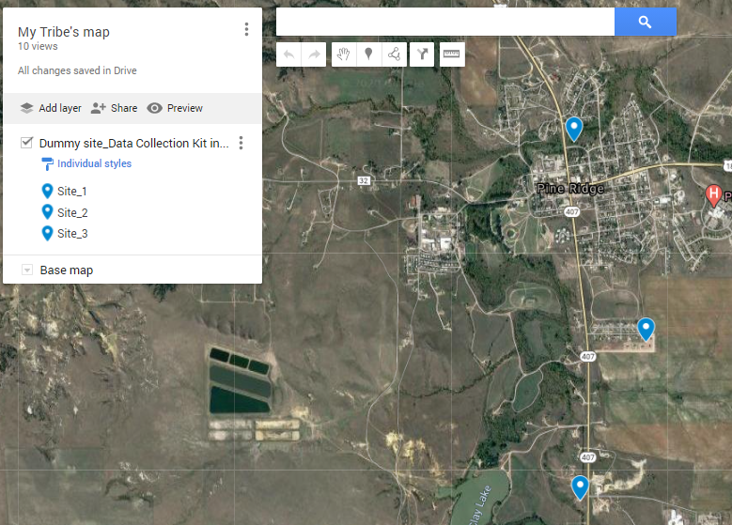
Using My Maps: PC
Site addition
9
7
8
Sites information placeholders
Name your markers
Sites view
Select all available attributes.
Click on “Continue”.
It is recommended to name the marker after the Site ID or the Site Name.
For this example, we named it after the Site Name.
Click on “Finish”.
This is how your site(s) will see.

Slide 23
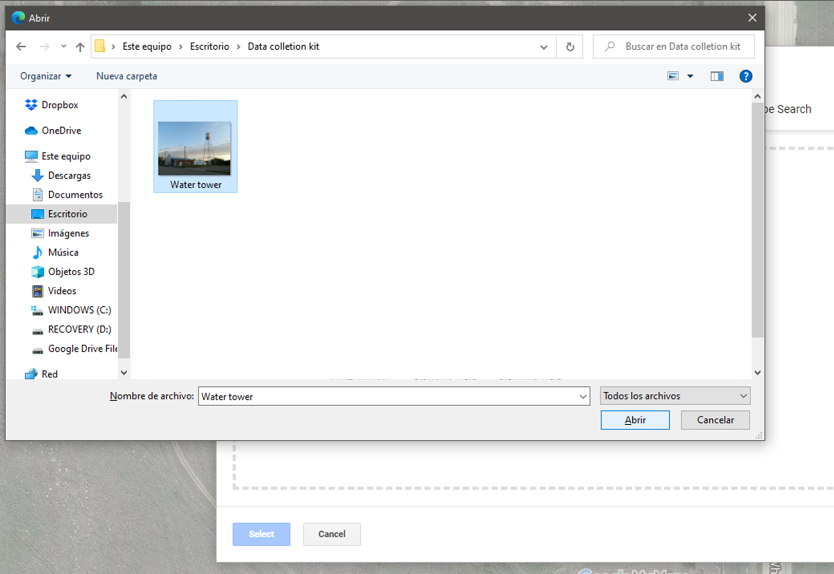
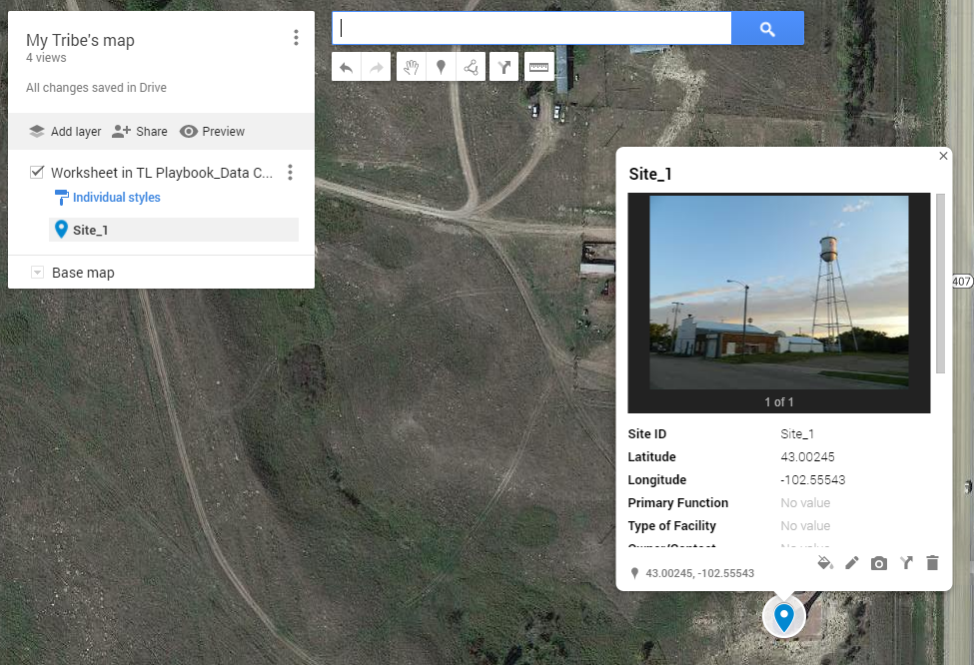
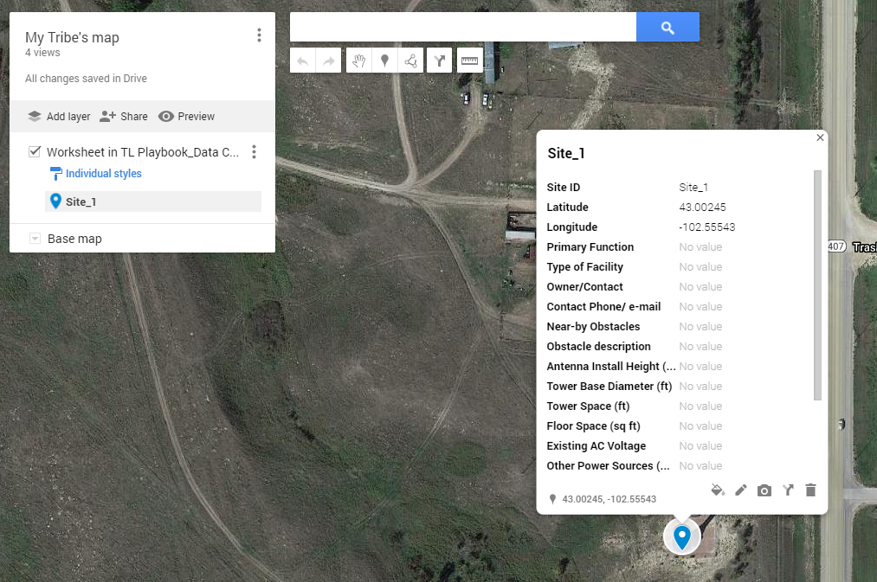
Photo addition
Photo upload from PC
2
1
Add picture of the site
Site’s final view
Select a site on the map to which you want to upload its photos.
Click on the camera icon.
Then select the picture(s) you want to upload.
This how the site will see at the end with the attached images.

Slide 24
Photo Report Guidelines
General Guidelines
Always verify quality of the image after capturing the photograph.
Avoid the use of digital zoom.
Ensure adequate lighting to take the photograph.
Before leaving the site, double check that all the photographic evidence has been gathered.
Add all the photos for each site to the My Maps Layer.

Slide 25
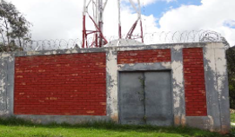
Photo Report Guidelines
Photo-Specific Guidelines
Front Facade
Image showing the face of the facility where the main entrance is located.
Tower / Rooftop
Panoramic
Nearby Obstacles
Floor /Equipment Room / Shelter space
Tower Foundations
Rack / Cabinet Space
Cabling Infra & Wall Openings
Backhaul Equipment

Slide 26
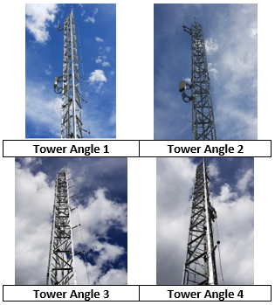
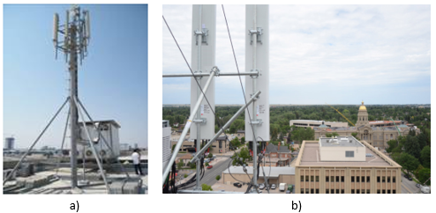
Photo Report Guidelines
Photo-Specific Guidelines
Picture of the existing tower or antenna mounting structure
For large structure take various angles
Front Facade
Tower / Rooftop
Panoramic
Nearby Obstacles
Floor /Equipment Room / Shelter space
Tower Foundations
Rack / Cabinet Space
Cabling Infra & Wall Openings
Backhaul Equipment

Slide 27
Photo Report Guidelines
Photo-Specific Guidelines
Panoramic View (Only for Rooftop).
Take various angles if space allows for it.
Front Facade
Tower / Rooftop
Panoramic
Nearby Obstacles
Floor /Equipment Room / Shelter space
Tower Foundations
Rack / Cabinet Space
Cabling Infra & Wall Openings
Backhaul Equipment

Slide 28
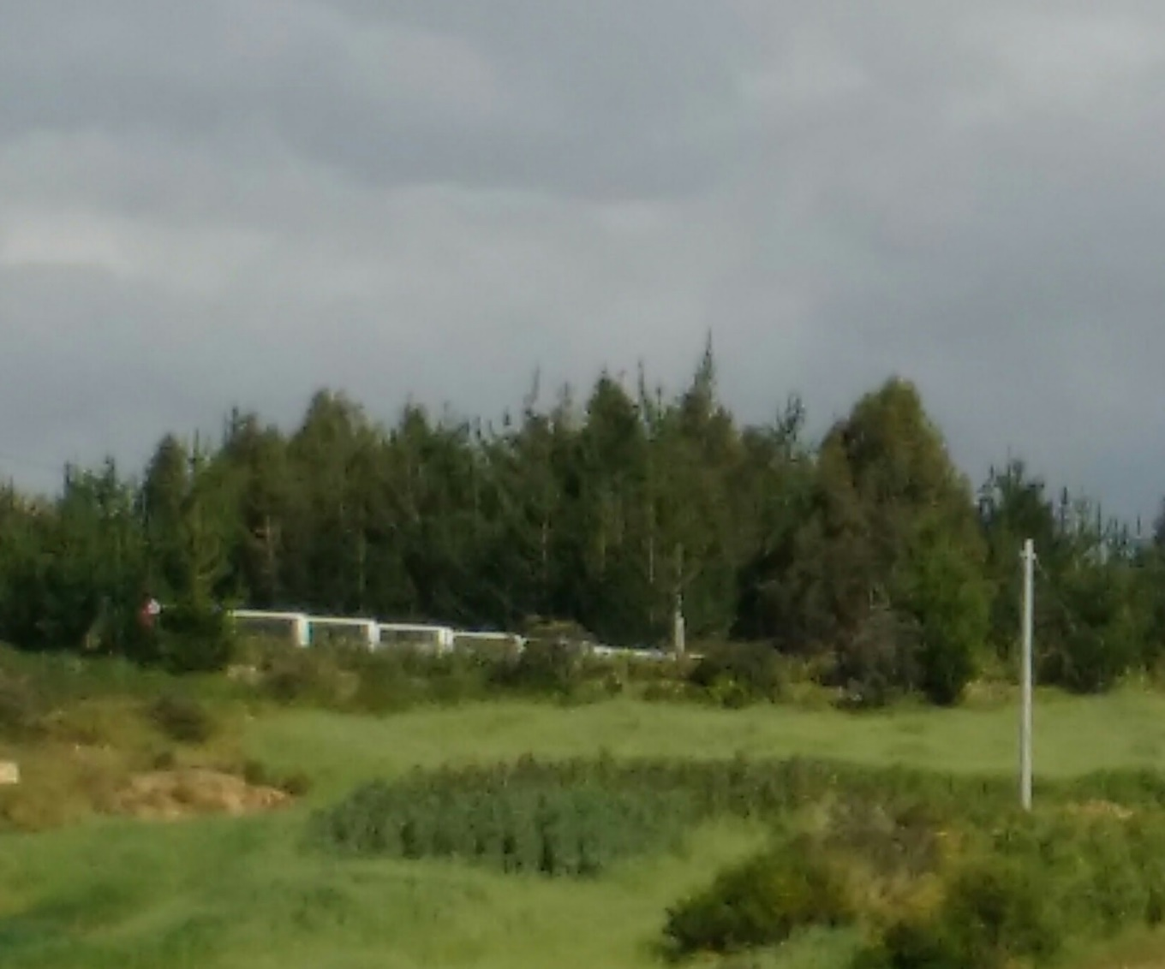
Photo Report Guidelines
Photo-Specific Guidelines
Picture(s) of nearby obstacles, such as trees, other buildings, mountains, or any object that could potentially obstruct.
Must correspond with obstacles described in the “Data Collection”.
Front Facade
Tower / Rooftop
Panoramic
Nearby Obstacles
Floor /Equipment Room / Shelter space
Tower Foundations
Rack / Cabinet Space
Cabling Infra & Wall Openings
Backhaul Equipment

Slide 29
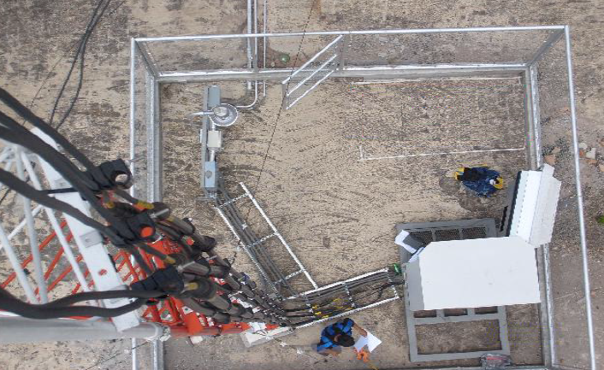
Photo Report Guidelines
Photo-Specific Guidelines
Picture that shows a wide view of the space on the floor or inside the shelter or equipment room.
Front Facade
Tower / Rooftop
Panoramic
Nearby Obstacles
Floor /Equipment Room / Shelter space
Tower Foundations
Rack / Cabinet Space
Cabling Infra & Wall Openings
Backhaul Equipment

Slide 30
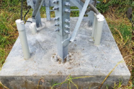
Photo Report Guidelines
Photo-Specific Guidelines
Image that shows the conditions of the tower foundations and other parts of the structure.
Look for structural issues such as rust or broken sections.
Front Facade
Tower / Rooftop
Panoramic
Nearby Obstacles
Floor /Equipment Room / Shelter space
Tower Foundations
Rack / Cabinet Space
Cabling Infra & Wall Openings
Backhaul Equipment

Slide 31
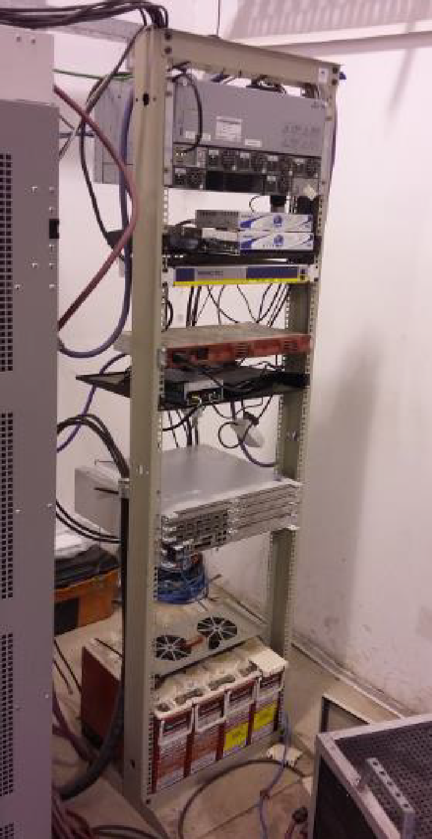
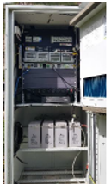
Photo Report Guidelines
Photo-Specific Guidelines
Front picture that shows the space available on the existing cabinet or rack (if it applies) to install new equipment.
Front Facade
Tower / Rooftop
Panoramic
Nearby Obstacles
Floor /Equipment Room / Shelter space
Tower Foundations
Rack / Cabinet Space
Cabling Infra & Wall Openings
Backhaul Equipment

Slide 32
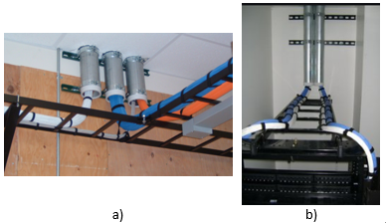
Photo Report Guidelines
Photo-Specific Guidelines
Pictures of existing cabling infrastructure including trays, ladders, cables and wall openings.
Front Facade
Tower / Rooftop
Panoramic
Nearby Obstacles
Floor /Equipment Room / Shelter space
Tower Foundations
Rack / Cabinet Space
Cabling Infra & Wall Openings
Backhaul Equipment

Slide 33
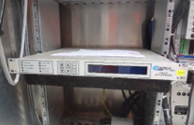
Photo Report Guidelines
Photo-Specific Guidelines
Front Facade
Front picture of existing backhaul equipment (If applicable).
Tower / Rooftop
Panoramic
Nearby Obstacles
Floor /Equipment Room / Shelter space
Tower Foundations
Rack / Cabinet Space
Cabling Infra & Wall Openings
Backhaul Equipment

Slide 34
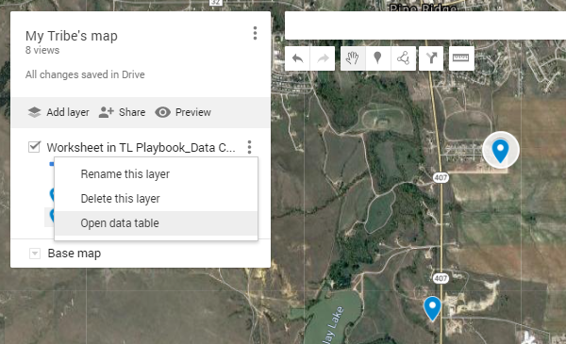
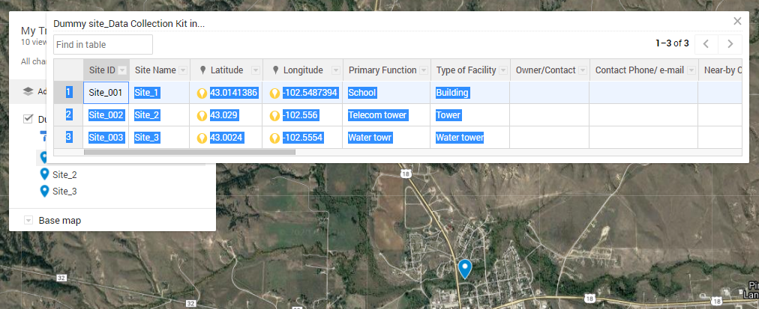
Export your data
Map data export – PC
The Network Planning & Design module requires basic map information: Site ID, Site Name and site coordinates.
To accomplish this, you must export map data into a format which Network Planning & Design module can work with.
Data can be exported on csv (comma delimited) or in KML format.
1
2
.
Open data table
Select data of the table
Select the bottom “three points icon”.
Then, select the “Open data table” option.
Select all data displayed on the table.
Tip: Drag the pointer from number “1” up to the last value on the table.
CSV export

Slide 35
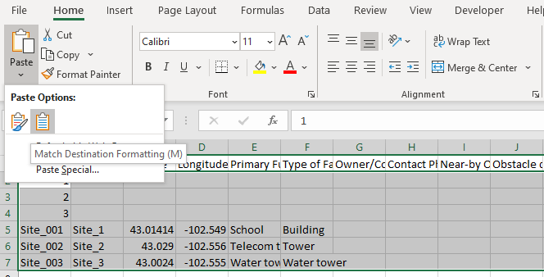
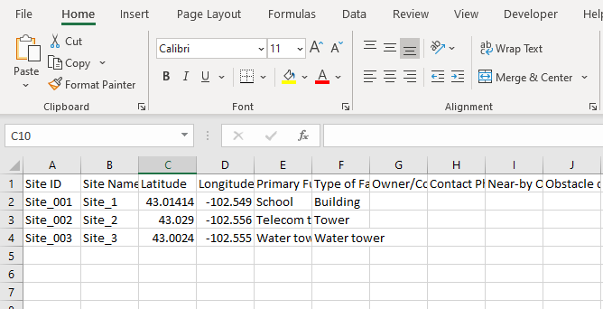
Export your data
Map data export – PC
3
4
Copy data on the csv template
Final view of the template
Open the “Template_csv for data export”.
Locate the pointer on cell A2. Then open the Paste options an select the “Match Destination Formatting” option.
Delete rows which contain only numbers.
This is how the template shall look at the end.
After filling the template, save the document as CSV (Coma delimited).
Once you have finished filling the template, you must save it as
CSV (Comma delimited).
CSV export

Slide 36
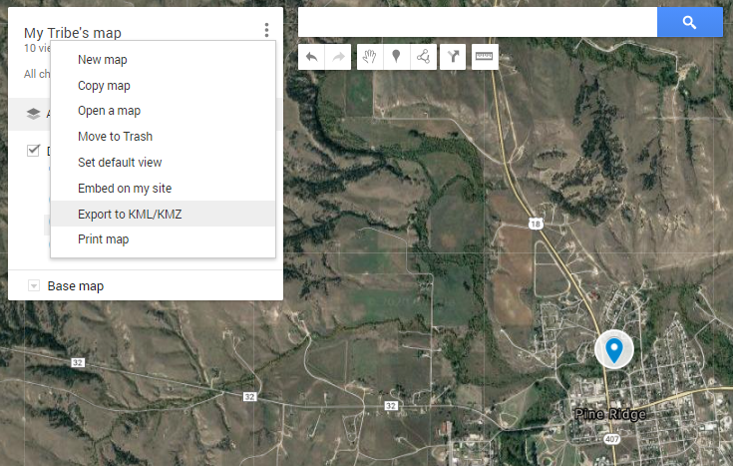
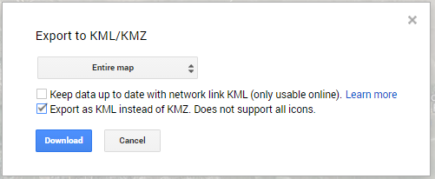
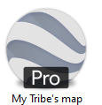
Export your data
Map data export – PC
1
2
Select KML export option
Export options
Select the top “three points icon”.
Then, select the “Export to KML/KMZ” option.
Select “Entire map” option and mark the second check box.
Then, click on the “Download” button.
KML export

